Slide 1
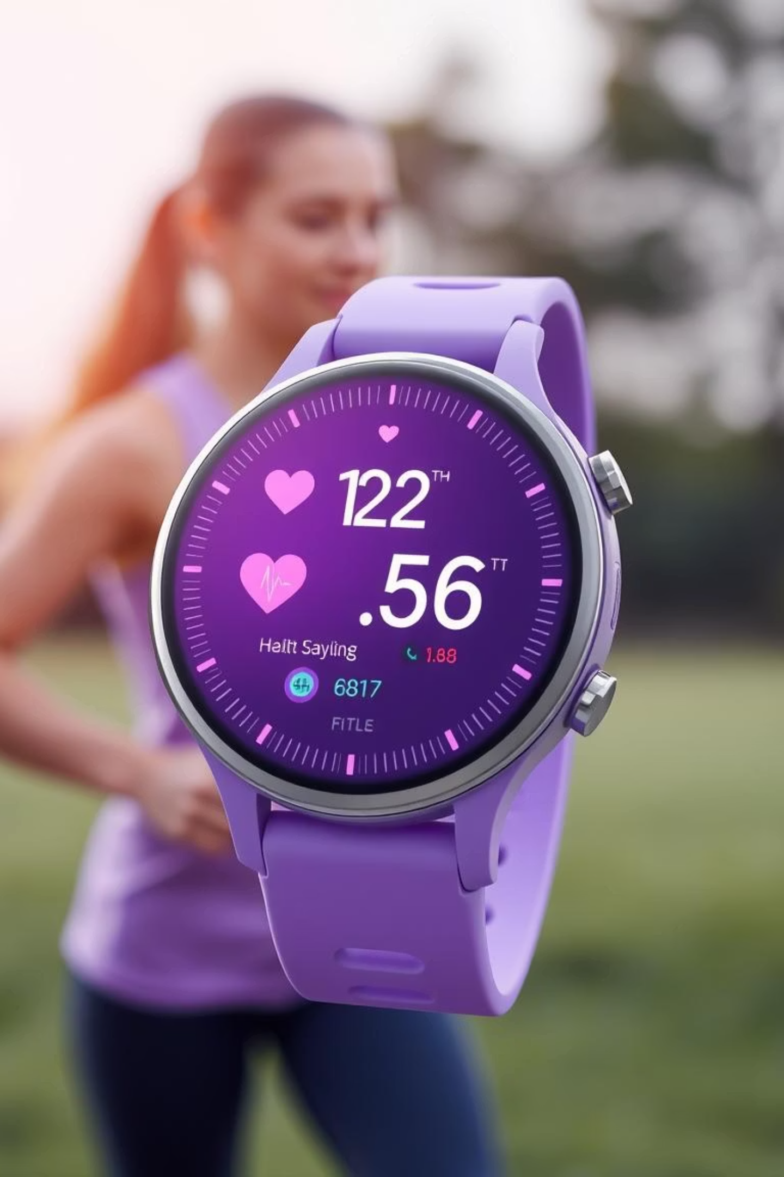
Wearable Health Signal Anomaly Detector
Your Smart Watch, Your Safety Net: Catching Unusual Events in Real-time

Slide 2
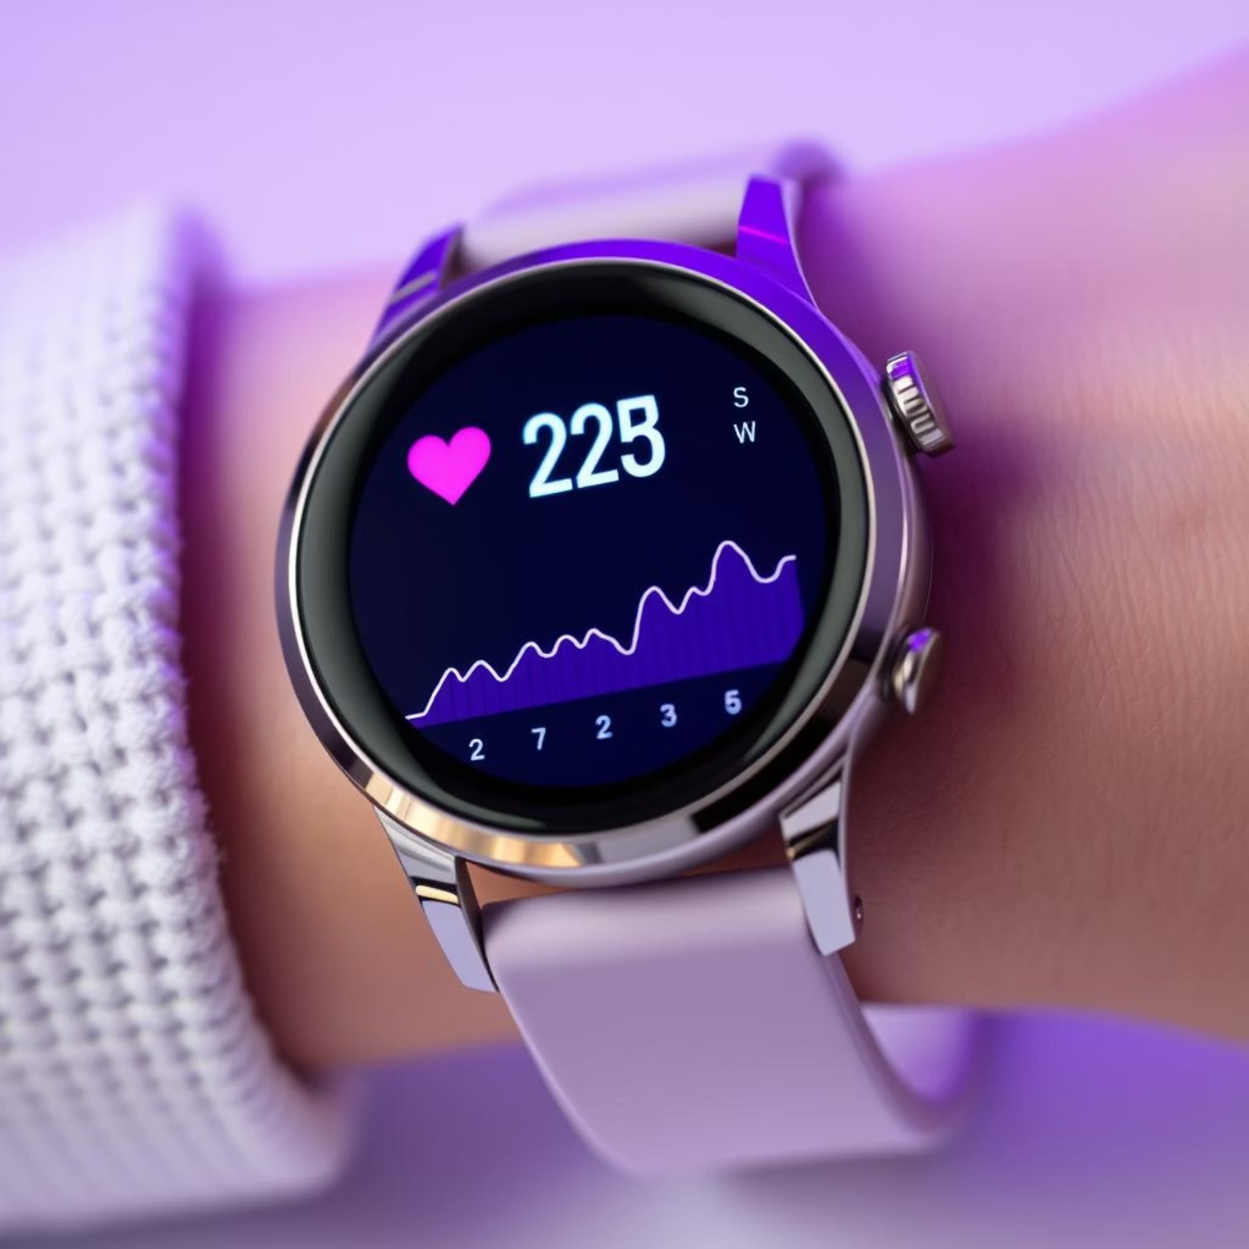
Project Overview & Problem Statement
Imagine: A smart system that constantly checks your health signals from a wearable device. It doesn't just know what you're doing,
but it also spots if something is unusual or potentially dangerous.
The Problem We're Solving:
Our Solution:
Sometimes, accidents happen (like a fall).
We've built a "Wearable Health Signal Anomaly Detector" that uses data from a smart
watch to:
Sometimes, sudden changes in activity might mean something's wrong
like going from running fast to suddenly stopping).
Understand your activities (rest, walk, run, fall, etc.).
We need a way to automatically detect these critical moments and
alert someone.
Spot anomalies – those unexpected or concerning patterns.
Potentially alert help when needed.
Our "Eyes" on You (Sensor Data):
Accelerometer (ACC): Measures your movement and
how you're oriented (like a motion sensor).
PPG / Heart Rate: Tracks your heart's activity.
SpO₂ (Blood Oxygen): Measures the
oxygen levels in your blood.

Slide 3


Data Acquisition & Preprocessing
Raw Data Acquisition :
Data Transformation & Cleaning :
We connected to a BLE (Bluetooth Low Energy) smart watch. Think of it as a wireless connection to get real-time health updates.
The raw data from the watch wasn't immediately usable – it was in a complex, technical format (hexadecimal code).
Our preprocessing step acted like a translator:
We recorded raw sensor signals (ACC, PPG, SpO₂) while performing different activities like resting, walking, running, and even simulated falls.
It converted these technical codes into meaningful numbers (e.g., actual acceleration values, heart rate, SpO₂ percentages).
Important: We carefully labeled each activity as we recorded it so our system could learn what each action looks like.
It also cleaned up any messy parts, like missing information or blank spaces, making sure the data was ready for analysis.
Result: Our initial "raw data" file.
Result: A clean, numerical dataset ready for the next steps.

Slide 4
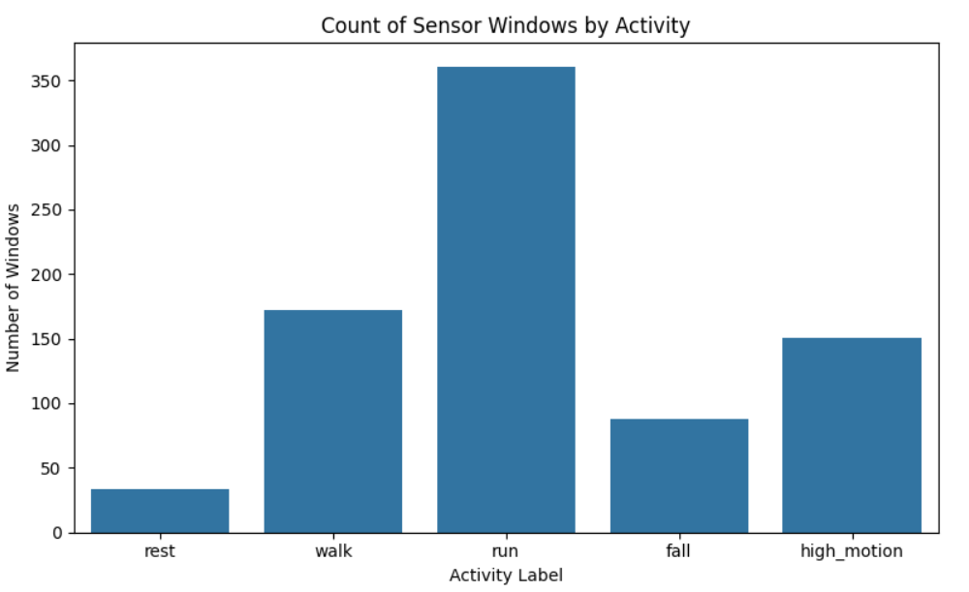
Data Visualization
The bar chart shows that “Walking” windows account for well over half of your samples, while “Running” and activities like “Climbing Stairs” make up only a small fraction.
This pronounced imbalance highlights that everyday behaviors dominate the dataset, while less common movements are under‑represented.

Slide 5
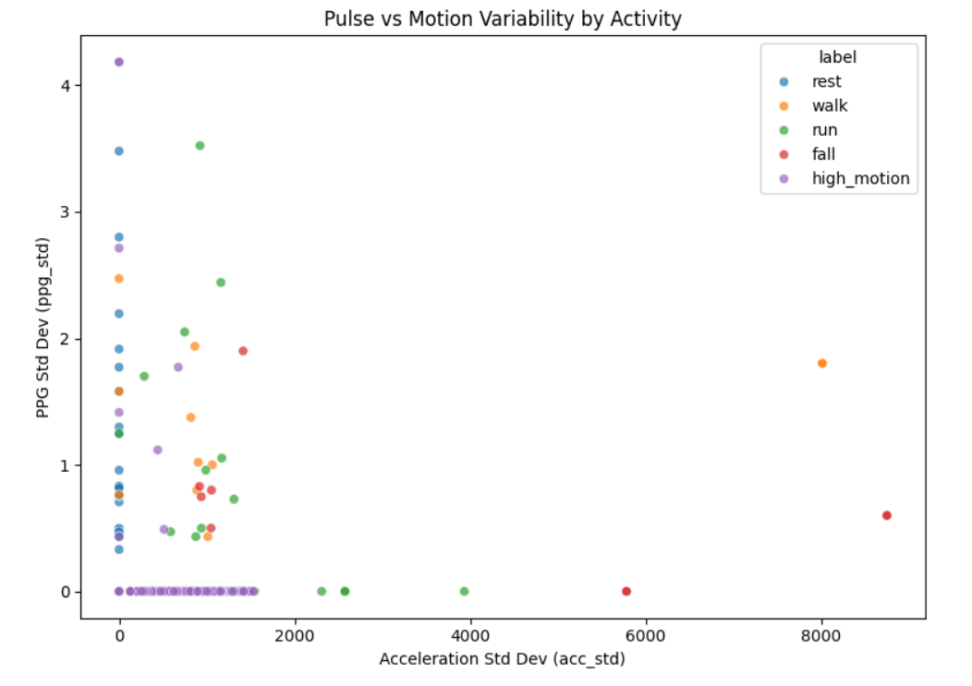
Low‑motion activities (Sitting, Standing) cluster at low motion and steady pulse variability.
High‑motion activities (Running, Jumping) display both high motion and noisy pulse readings.
Intermediate activities (Walking, Climbing Stairs) sit between these extremes.
A few outliers (high pulse noise with low motion) may indicate loose sensors or brief physiological spikes.

Slide 6
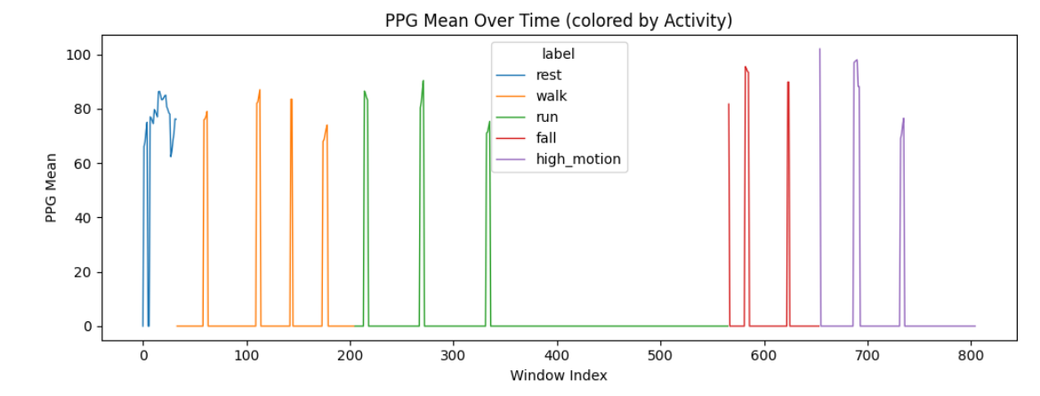
Transitions into Running correspond with clear and sustained increases in the average pulse curve, reflecting elevated cardiovascular demand as soon as the activity begins.
Walking segments produce a moderate rise in pulse relative to resting, forming a distinct mid‑level plateau that bridges the gap between rest and intense exercise.
During Sitting, the pulse trace remains at lower, flatter levels, indicating a restful state with minimal exertion.

Slide 7
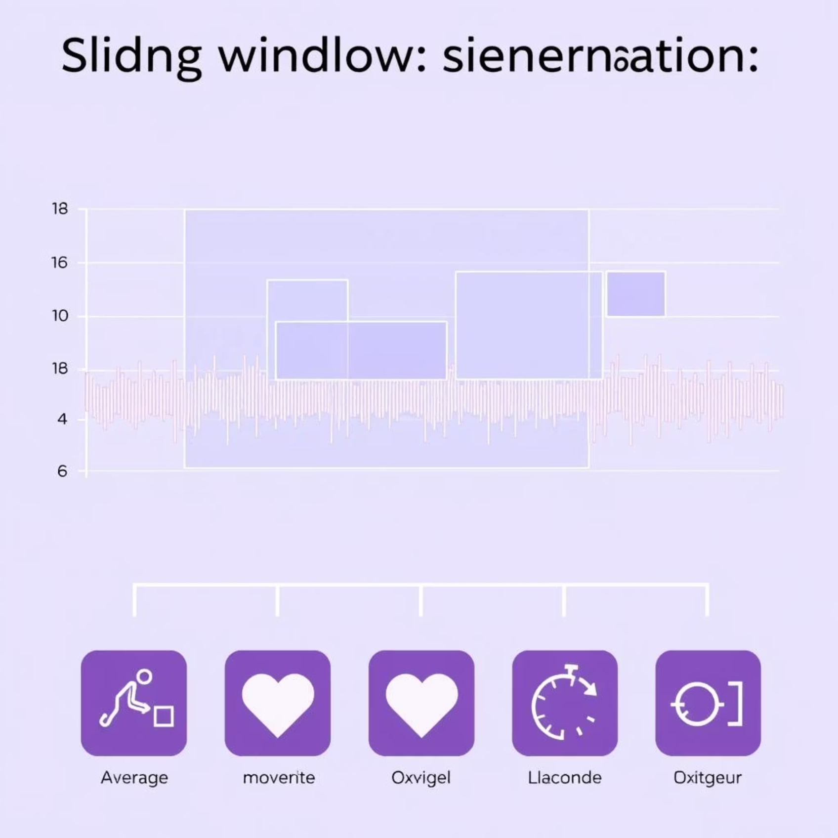

Feature Engineering & Dataset Analysis
Why Feature Engineering? Imagine trying to understand a book by just reading individual letters. It's hard! Instead, we look for words,
sentences, and paragraphs.
Similarly, raw sensor data is like individual letters. We need to extract "features"
– specific measurements and patterns – that describe the activity.
Sliding Window Segmentation:
We don't look at individual sensor readings. Instead, we take small, overlapping "snapshots" of data, like a short video clip (e.g., an 8-second window). This helps us see the full picture of an activity.
Multimodal Feature Extraction (20 Features):
From each snapshot, we calculated 20 different smart measurements:
Accelerometer (ACC) Features (13): Mean, Standard Deviation, Min, Max, Median, Skewness, Kurtosis, Jerk Max (rate of acceleration change), Peak Count, Bandpower (frequency domain), Step Frequency, Zero-Crossing Rate.
PPG Features (4): Mean, Standard Deviation, RMSSD (Heart Rate Variability), Slope.
SpO₂ Features (3): Mean, Standard Deviation, Rate of Change.
These features help our system really understand what kind of activity is happening.
Dataset Imbalance Observation :
When we looked at our collected data, we noticed we had far fewer "fall" examples than other activities. This was a crucial discovery because it meant our system might struggle to learn about falls.

Slide 8


Model Training & Data Augmentation
Addressing Class Imbalance :
Machine Learning Pipeline Construction :
Since falls are rare but important, we "taught" our system more about them.
We built a sophisticated machine learning "pipeline" – think of it as a multi-step learning process:
How: We took our existing "fall" data and slightly tweaked it (added tiny, harmless "noise") to create new, synthetic fall examples.
Imputation: Automatically handles any remaining missing data.
Feature Scaling: Makes sure all our 20 features are on the same scale, so none unfairly dominate the learning.
Goal: Make sure our system saw enough fall examples to learn how to identify them accurately.
SMOTE (Synthetic Minority Oversampling Technique): Applied during training to further balance classes, especially critical for fall detection.
Ensemble Classification (Stacking Model): This is the core "decision-maker." It combines the strengths of two powerful learning methods (Random Forest and Logistic Regression) to make very accurate predictions.
The Outcome: Our trained model is now ready to identify activities and spot anomalies.

Slide 9
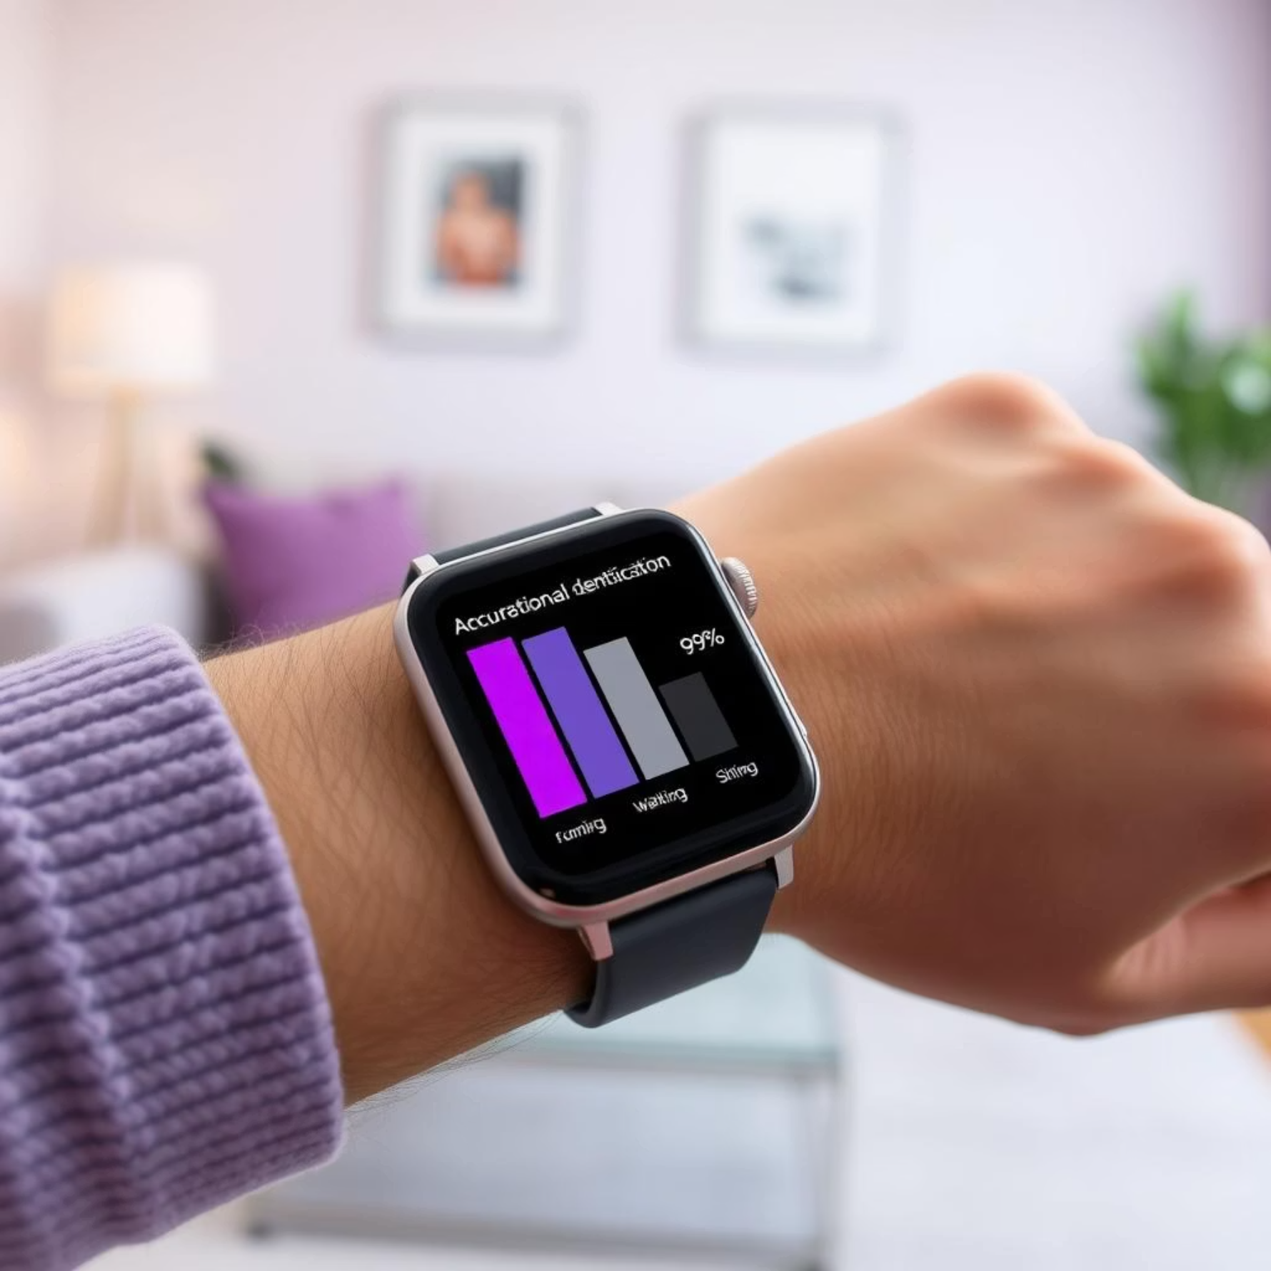
Model Performance & Anomaly Detection Logic
Performance Evaluation (70% Accuracy):
Overall, our system achieved about 70% accuracy in correctly identifying
activities.
Crucially: The data balancing and advanced model helped us significantly improve the system's ability to detect 'fall' events – this is vital for our anomaly detection.

Slide 10
Anomaly Detection Mechanism (The Core Insight!):
Our project isn't just about knowing if you're walking or resting. It's about detecting abnormal transitions that might signal a problem.
High Motion to Su1dden Rest Transition:
Imagine someone running very fast and then suddenly coming to a complete stop and staying rest. This is unusual and could mean a sudden accident or collapse. This triggers an alert!
Fall Event Followed by Prolonged Rest:
If a fall is detected, and the person remains in a rest state immediately afterward (not getting up), this also triggers an alert! It suggests a fall where the person needs help.
1
2
Normal Behavior: If you just stop running to rest, or walk and then rest, these are considered normal and do not trigger alerts.
Why this matters: This smart logic helps us focus on truly concerning events, reducing false alarms and ensuring help is sent when genuinely needed.

Slide 11
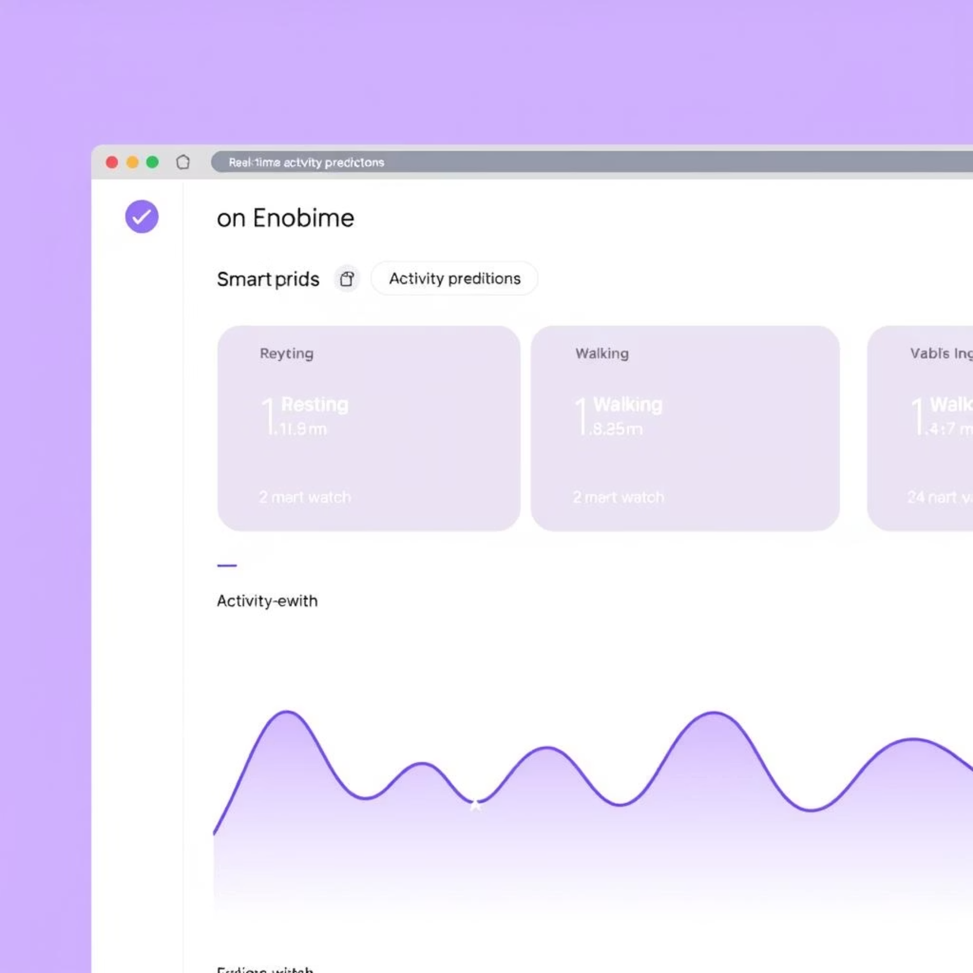

Real-time Monitoring & System Deployment
Live Monitoring Dashboard :
We built a real-time web monitor that runs in your browser.
It's constantly connected to the BLE watch, receiving live sensor data.
As data comes in, it immediately extracts the 20 features we discussed, feeds them into our trained model, and gets a live prediction of your current activity.
What you see: A simple web page shows you what activity the system currently thinks the person is doing (e.g., "Resting," "Walking").
The Anomaly Watcher: Behind the scenes, this monitor is also constantly checking for those specific anomalous patterns and is ready to trigger an alert.
Operational Significance:
This live demonstration shows how our system can provide immediate insights and potentially save lives by detecting critical situations as they happen.

Slide 12





Future Work & Conclusion
Future Enhancements:
Automated Alerting Integration:
Automatically send SMS messages to caregivers or emergency services when an anomaly is detected.
Dataset Expansion & Diversity:
Collect even more diverse data from many different people and situations to make the system even more robust.
Advanced AI Architectures:
Explore cutting-edge AI techniques (like Deep Learning models for sequential data) for potentially higher accuracy and more subtle anomaly
detection.
Edge Computing Deployment:
Investigate deploying simplified models directly onto the wearable device itself for faster, more private processing and reduced power consumption.
Personalized Anomaly Detection:
Customize the system to learn the unique activity patterns of each individual user for more accurate and personalized alerts.

Slide 13
In Conclusion:
We've successfully created a "Wearable Health Signal Anomaly Detector" that not only understands human activities from a smart watch but,
most importantly, identifies critical, unusual events in real-time.
This technology has immense potential to improve safety, particularly for vulnerable populations, and provide peace of mind through proactive,
Intelligent monitoring.

